Slide 1

计算机组成与系统结构 Computer Organization & System Architecture
Huang Kejie (百人计划研究员)
Office: 玉泉校区老生仪楼304
Email address: huangkejie@zju.edu.cn
HP: 17706443800

Slide 2
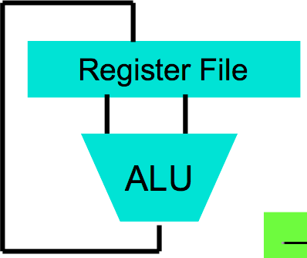
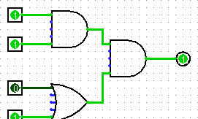
Great Idea #1: Abstraction
(Levels of Representation/Interpretation)
lw t0, t2, 0
lw t1, t2, 4
sw t1, t2, 0 sw t0, t2, 4
High Level Language Program (e.g., C)
temp = v[k]; v[k] = v[k+1]; v[k+1] = temp;
Anything can be represented
as a number, i.e., data or instructions
Compiler
Assembly Language Program (e.g., RISC-V)
Assembler
0000 | 1001 | 1100 | 0110 | 1010 | 1111 | 0101 | 1000
1010 | 1111 | 0101 | 1000 | 0000 | 1001 | 1100 | 0110
1100 | 0110 | 1010 | 1111 | 0101 | 1000 | 0000 | 1001
0101 | 1000 | 0000 | 1001 | 1100 | 0110 | 1010 | 1111
Machine Language Program (RISC-V)
Machine Interpretation
We are here!
Hardware Architecture Description (e.g., block diagrams)
Architecture Implementation
Logic Circuit Description (Circuit Schematic Diagrams)

Slide 3
Switches: Basic Element of Physical Implementations
Implementing a simple circuit (arrow shows action if wire changes to “1” or is asserted):
Compose switches into more complex ones (Boolean functions):
A
Z
Close switch (if A is “1” or asserted) and turn on light bulb (Z)
A
Z
Open switch (if A is “0” or unasserted) and turn off light bulb (Z)
Z ≡ A
A
A
B
OR
AND
Z ≡ A and B
Z ≡ A or B
B

Slide 4
CMOS Transistors
Three terminals: source, gate, and drain
Switch action: if voltage on gate terminal is (some amount) higher/lower than source terminal then conducting path established between drain and source terminals (switch is closed)
Gate
Source
Drain
Gate
Note circle symbol to indicate “NOT” or “complement”
Gate
Source
Drain
Source
Drain
n-channel transitor open when voltage at Gate is low closes when:
voltage(Gate) > voltage (Threshold)
(High resistance when gate voltage Low,
Low resistance when gate voltage High)
p-channel transistor closed when voltage at Gate is low opens when:
voltage(Gate) > voltage (Threshold)
(Low resistance when gate voltage Low,
High resistance when gate voltage High)

Slide 5
MOS Networks
p-channel transistor closed when voltage at Gate is low opens when:
voltage(Gate) > voltage (Threshold)
X
what is the relationship between x and y?
1v
x
y
Y
0 volts
(gnd)
0v
1 volt
(Vdd)
n-channel transitor open when voltage at Gate is low closes when:
voltage(Gate) > voltage (Threshold)
Called an inverter or not gate

Slide 6
Two Input Networks
what is the relationship between x, y and z?
X
Y
x
y
z
1v
0 volts
0 volts
0 volts
1 volt
Z
1 volt
0 volt
0v
1 volt
1 volt
X
Y
x
y
z
0 volts
0 volts
1v
0 volts
1 volt
Z
1 volt
0 volt
1 volt
1 volt
0v

Slide 7
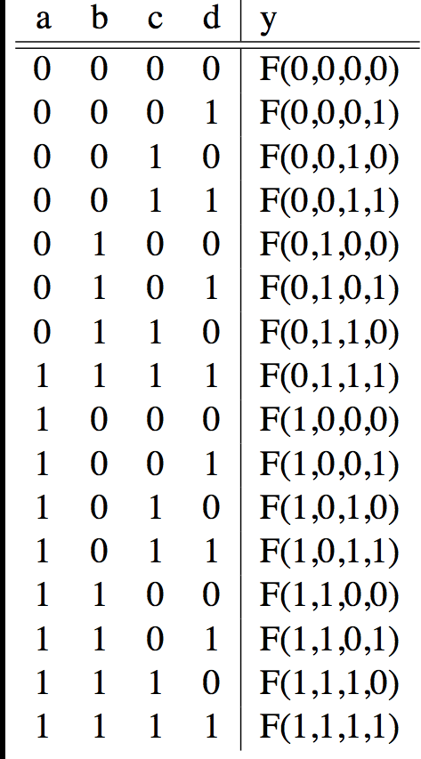
Truth Tables List outputs for all possible inputs
A
F
B
Y
C
D

Slide 8
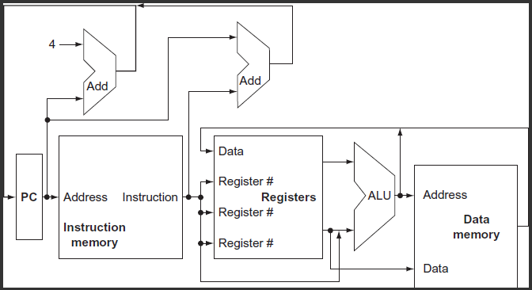
A Conceptual RISC-V Datapath

Slide 9
Logisim
Free schematic capture/logic simulation program in Java
“A graphical tool for designing and simulating logic circuits”
Search and download version 2.7.1, online tutorial
ozark.hendrix.edu/~burch/logisim/
Drawing interface based on toolbar
Color-coded wires aid in simulating and debugging a circuit
Wiring tool draws horizontal and vertical wires, automatically connecting to components and to other wires.
Circuit layouts used as "subcircuits" of other circuits, allowing hierarchical circuit design
Included circuit components: inputs and outputs, gates, multiplexers, arithmetic circuits, flip-flops, RAM memory

Slide 10
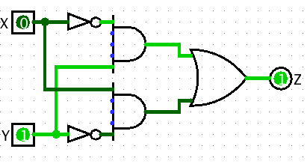
Logisim Wires
Blue wires: value at that point is "unknown”
Gray wires: not connected to anything
OK when in process of building a circuit
When finished => wires not be blue or gray
If connected, all wires should be green
Bright green a 1
Dark green a 0

Slide 11
Common Mistakes in Logisim
Connecting wires together
Using input for output
Connecting to edge without connecting to actual input
Unexpected direction of input

Slide 12
Types of Circuits
Synchronous Digital Systems consist of two basic types of circuits:
Combinational Logic (CL) circuits
Output is a function of the inputs only, not the history of its execution
E.g., circuits to add A, B (ALUs)
Last lecture was comninational logic
Sequential Logic (SL)
Circuits that “remember” or store information
aka “State Elements”
E.g., memories and registers (Registers)
Rest of today’s lecture is sequential logic

Slide 13
Program Counter: First Design
Program Counter “PC”
Instruction address
Next PC: add 4 to current value
Let’s try …
Something is not quite right:
PC and PC+4 simutaneously on same wire???
PC + 4

Slide 14
Fix
Memory element breaks the feedback loop
How does it work?

Slide 15
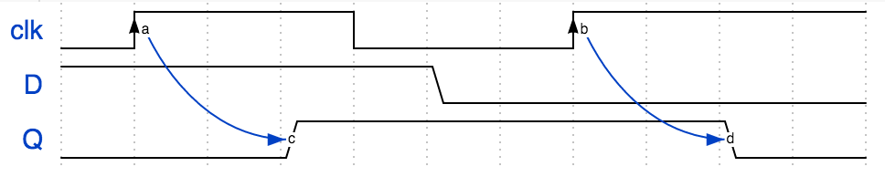
(Positive) Edge Triggered Flip-Flop
D
Q
clk
RS latch operates on input levels
D FF operates on (clock) edges
Clock “clk”
Time

Slide 16
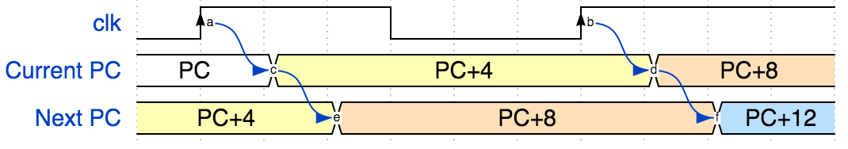
Program Counter: Improved Design
Current PC
Next PC

Slide 17
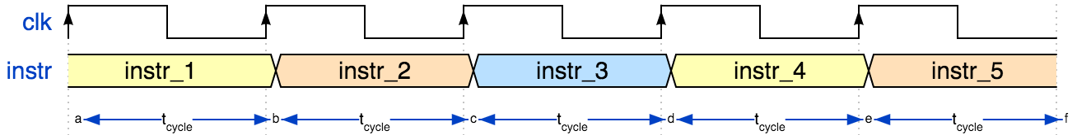
Clock
f_{s} = 1/ t_{cycle}
Clock frequency f_{s} | Period t_{cycle} = 1/f_{s}
CPU 2.5 GHz | 400 ps
Drum/heartbeat, 1Hz | 1 s

Slide 18
Maximum Clock Speed
How fast can the PC circuit operate?
I.e. what is the maximum clock frequency?
Let’s look at the timing requirements of each part
Let’s start with the flip-flop

Slide 19
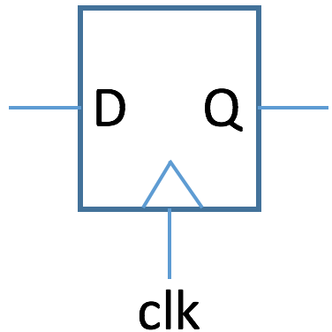
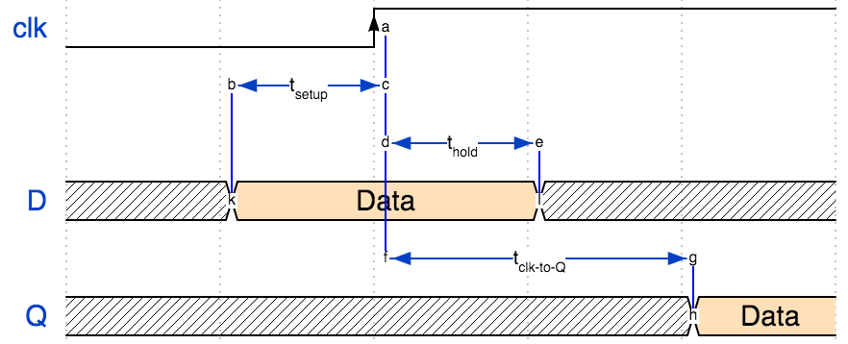
Flip-Flop Timing

Slide 20
Flip-Flop Timing
Time | Description
t_{setup} | time during which D must not change before positive clock edge
t_{hold} | time during which D must not change after positive clock edge
t_{clk-to-Q} | delay after positive clock edge after which D appears at Q output

Slide 21
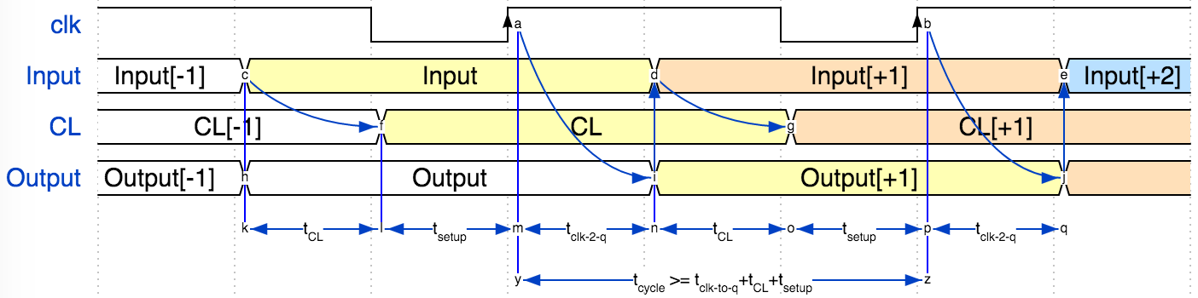
Maximum Clock Speed
t_{CL}
Clock
Input
Combinatorial
Logic
(CL)
Register
(flip-flops)
CL
Output
Optional Feedback

Slide 22
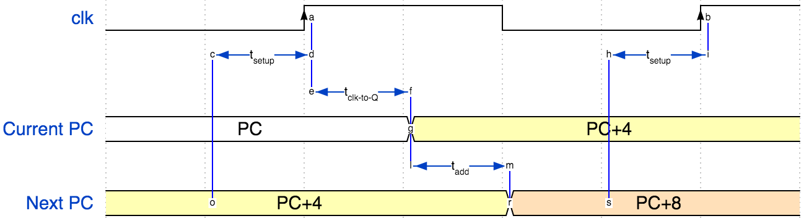
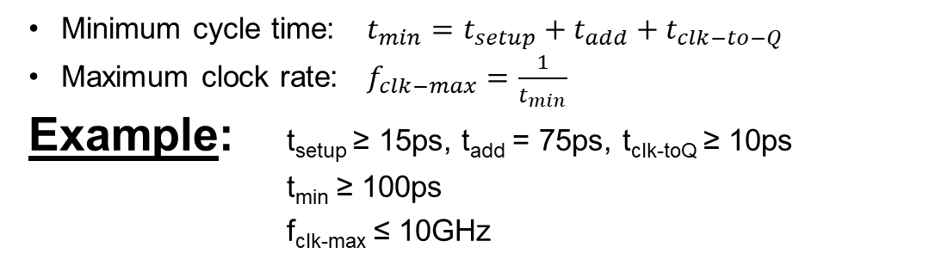
Maximum PC Clock Speed
Minimum cycle time: $t_{min}=t_{setup}+t_{add}+t_{clk−to−Q}$
Maximum clock rate: $f_{clk−max}=\frac{1}{t_{min}}$
Example: t_{setup} ≥ 15ps, t_{add} = 75ps, t_{clk-toQ} ≥ 10ps
t_{min} ≥ 100ps
f_{clk-max} ≤ 10GHz

Slide 23
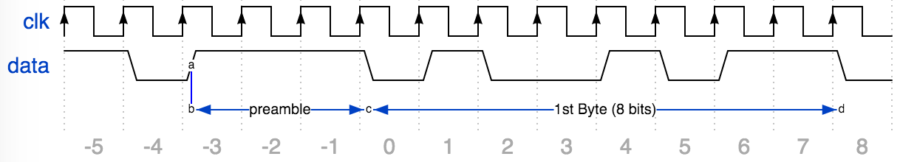
Example: Serial Communication
Wifi sends data “1 bit at a time”
How do we know where a byte “starts”?
Send “preamble …”
E.g. 3 one’s in a row

Slide 24
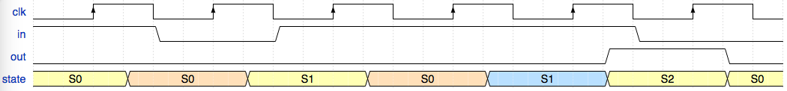
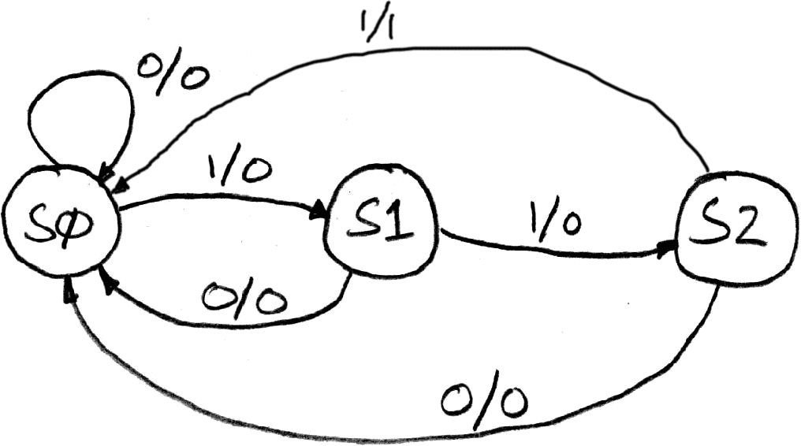
FSM to Detect 3 One’s
* FSM = Finite State Machine
State transitions are controlled by the clock: on each clock cycle the FSM
checks the inputs,
transitions to a new state, and
produces a new output …
FSM to detect the occurrence of 3 consecutive 1’s in the input.
State transition diagram:
Input/output
S1: detected 1
S0: idle
S2: detected 11

Slide 25
FSM Combinatorial Logic
State Encoding
Truth Table
State | Code
S0 | 00
S1 | 01
S2 | 10
unused | 11
PS | Input | NS | Output
XX | 0 | 00 | 0
00 | 1 | 01 | 0
01 | 1 | 10 | 0
10 | 1 | 00 | 1
11 | X | 00 | 0

Slide 26
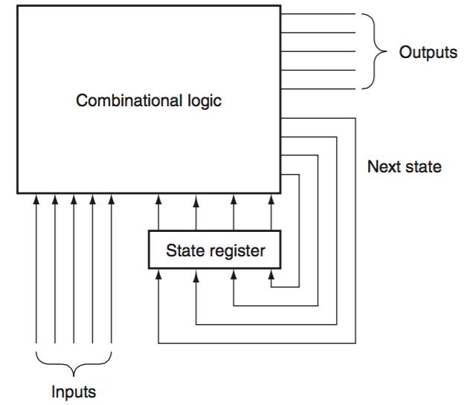
Hardware Implementation of FSM

Slide 27
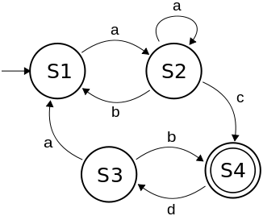
Finite State Machines (FSM) - Summary
Describe computation over time
Represent FSM with “state transition diagram”
Start at given state and input, follow some edge to next (or same) state
With combinational logic and registers, any FSM can be implemented in hardware
state transition diagram

Slide 28
Conceptual RISC-V Datapath

Slide 29
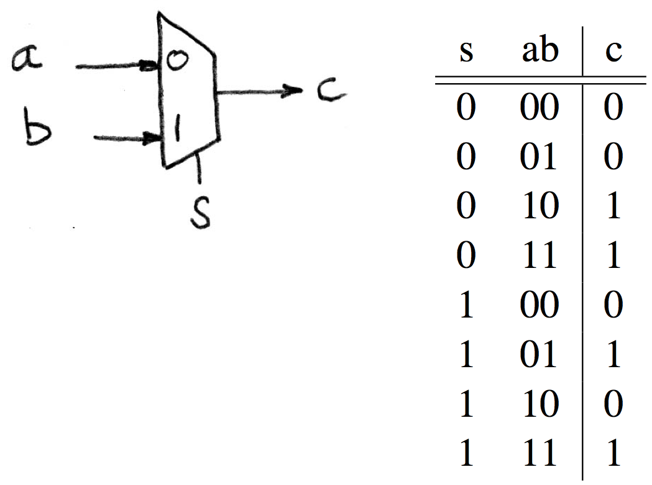
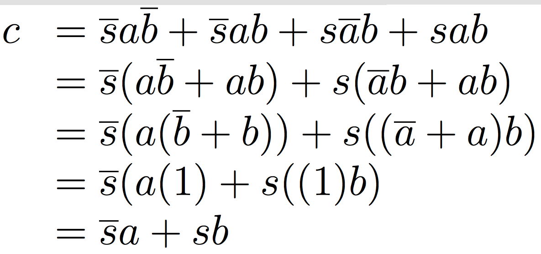
Data Multiplexer (e.g., 2-to-1 x n-bit-wide)

Slide 30
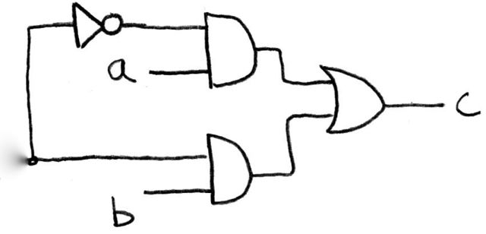
How Do We Build a 1-bit-Wide Mux (in Logisim)?

Slide 31
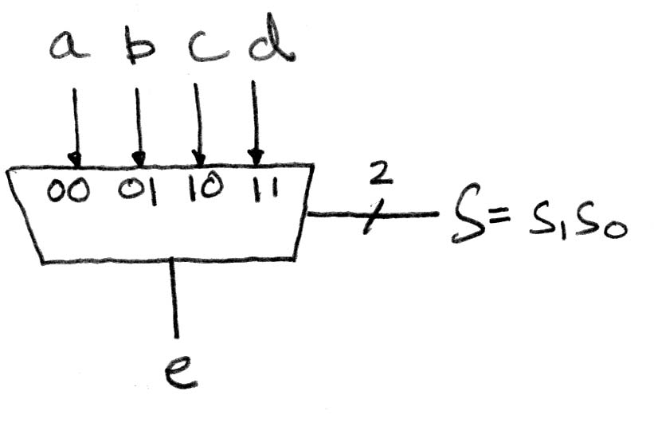
4-to-1 Multiplexer
How many rows in Truth Table?

Slide 32
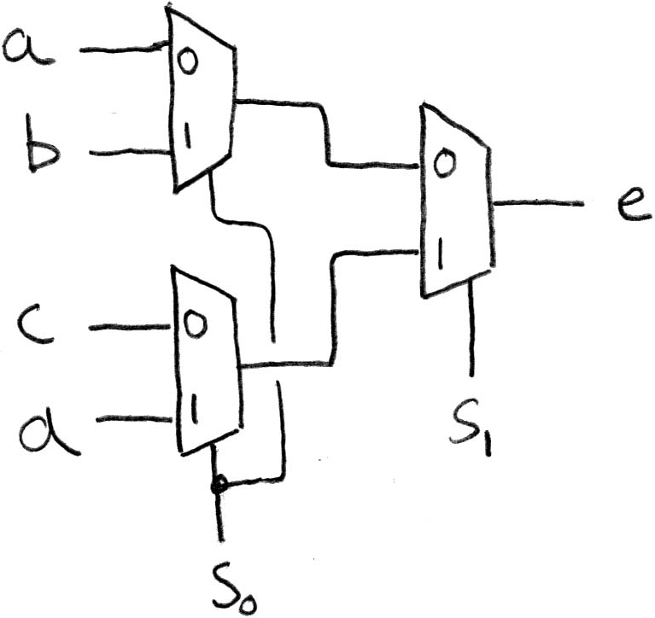
Alternative Hierarchical Approach (in Logisim)

Slide 33
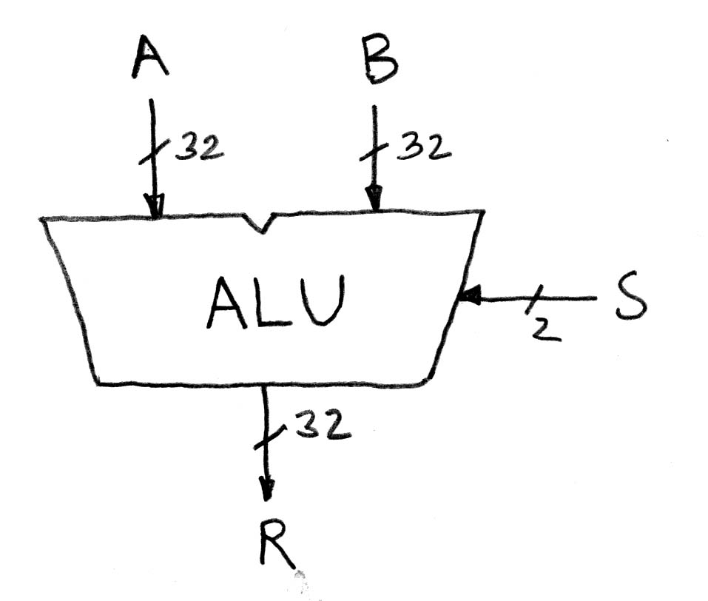
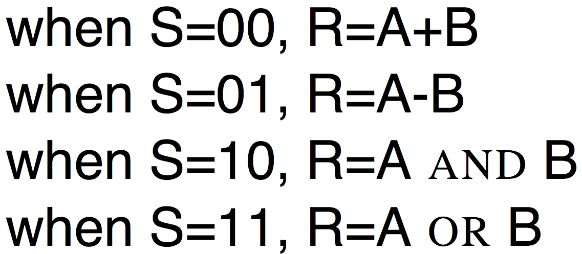
Arithmetic and Logic Unit
Most processors contain a special logic block called “Arithmetic and Logic Unit” (ALU)
We’ll show you an easy one that does ADD, SUB, bitwise AND, bitwise OR

Slide 34
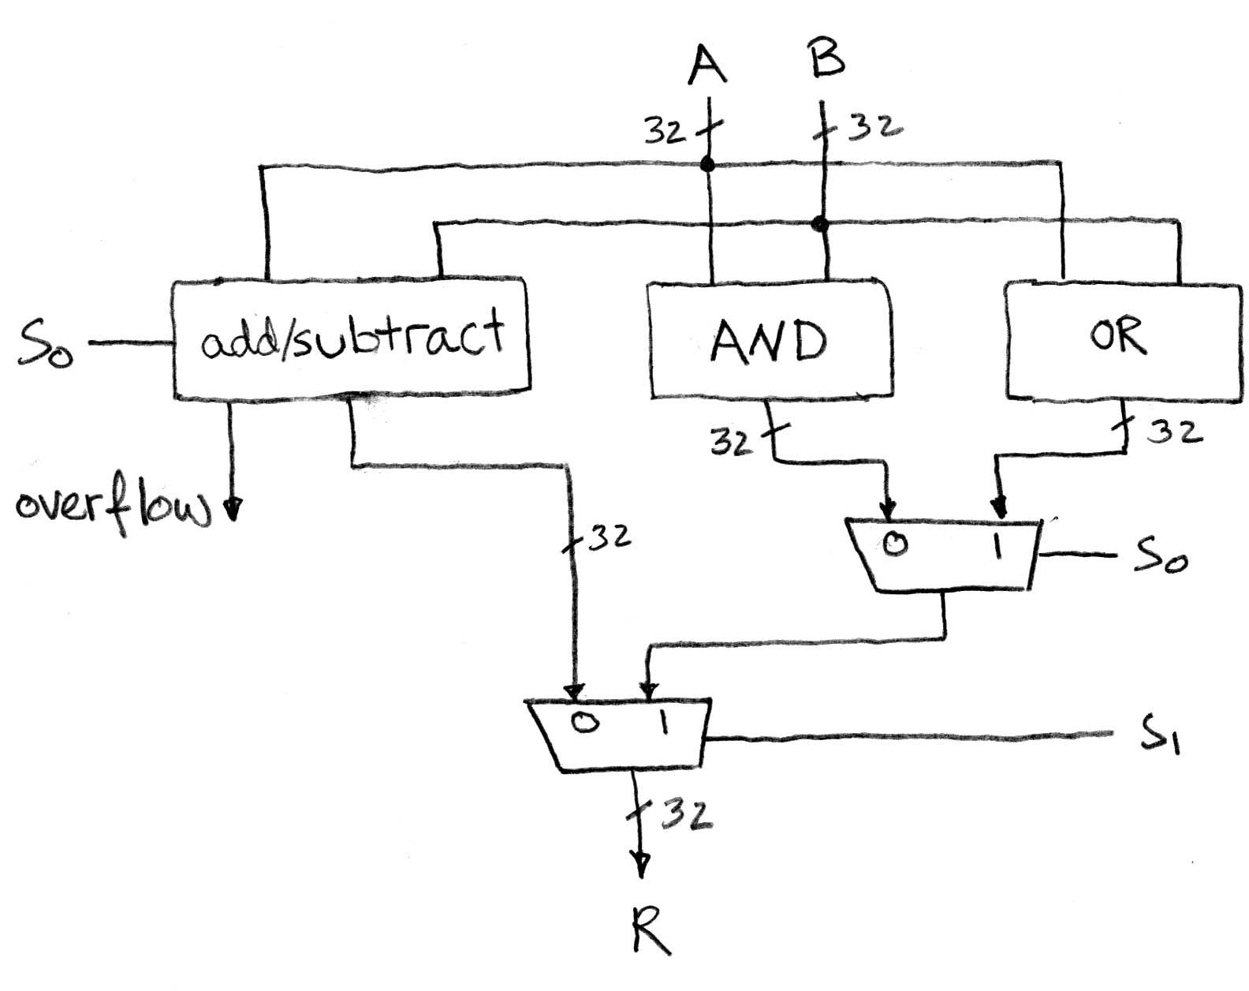
Simple ALU

Slide 35
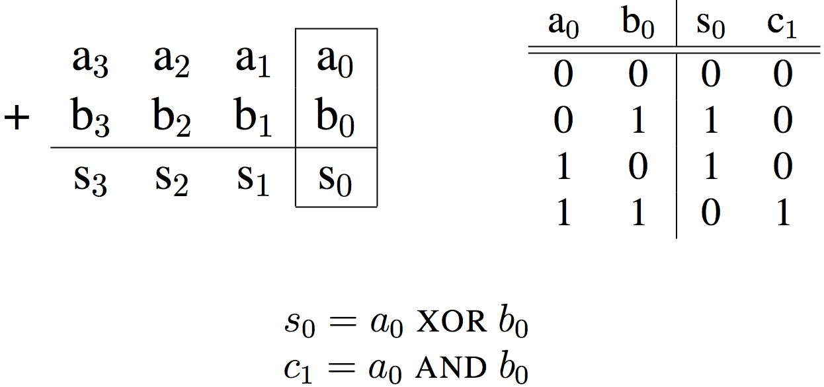
Adder/Subtractor: One-bit adder Least Significant Bit
Half Adder

Slide 36
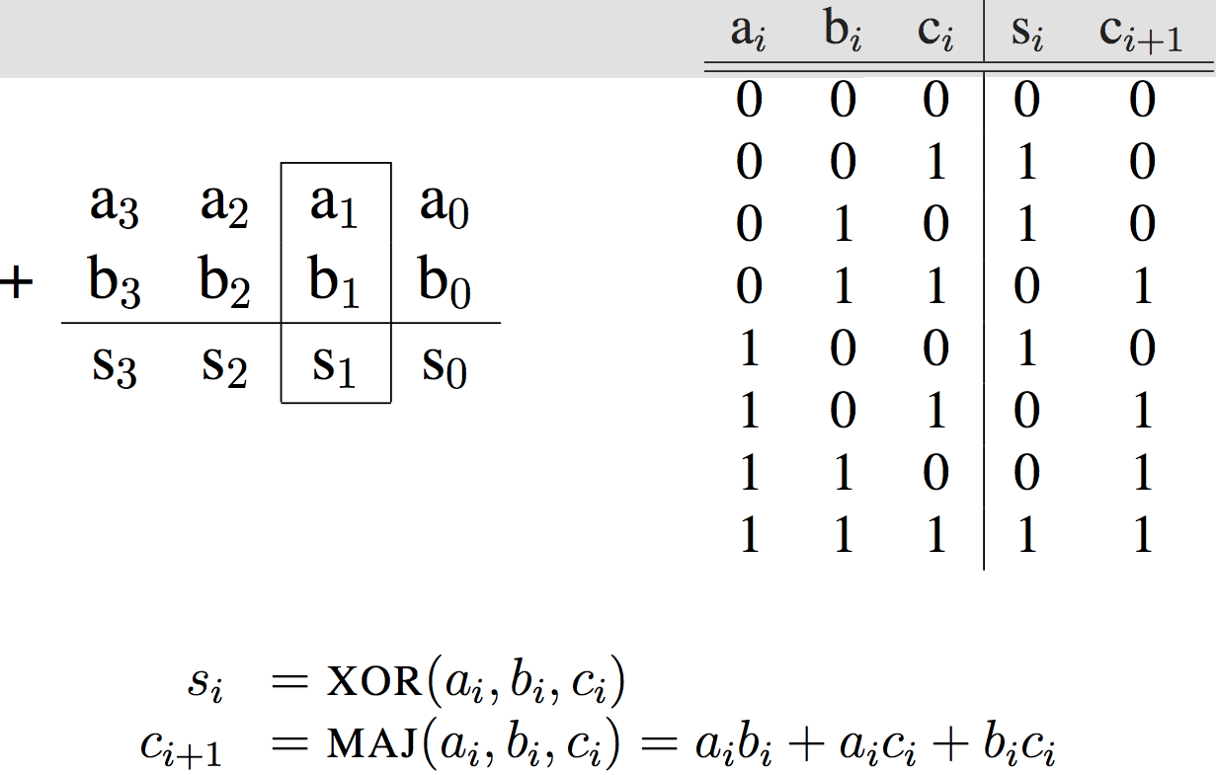
Adder/Subtractor: One-bit adder (1/2) …
Full Adder

Slide 37
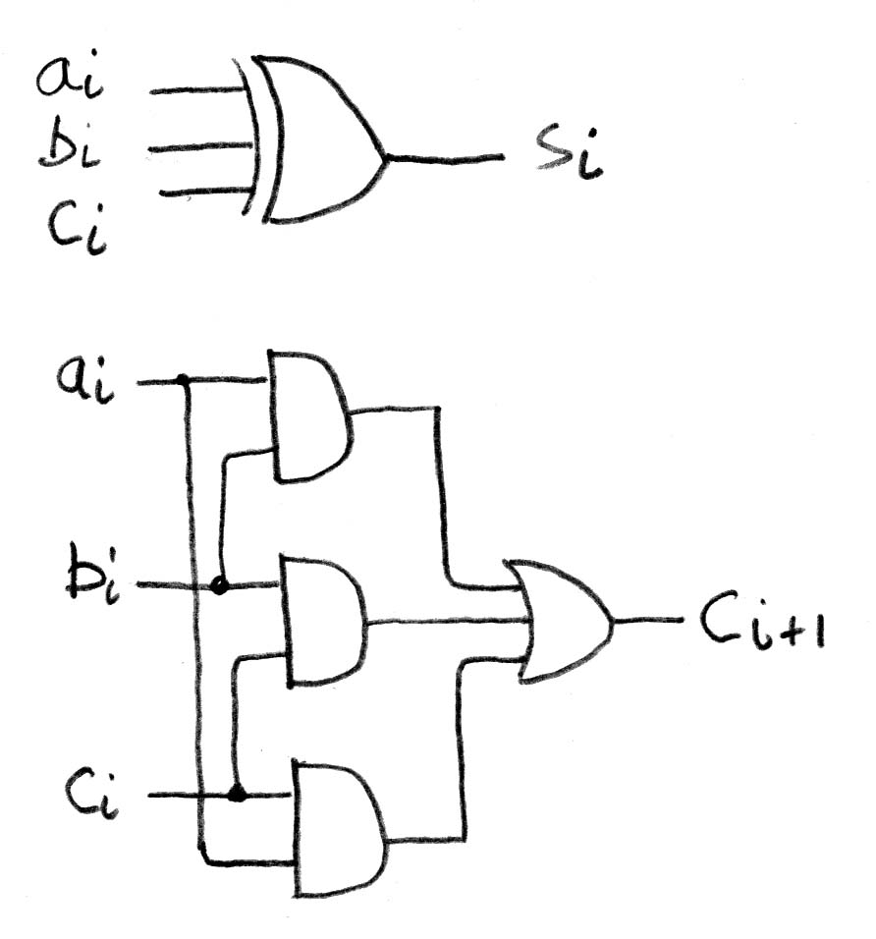
Adder/Subtractor: One-bit Adder (2/2) …

Slide 38
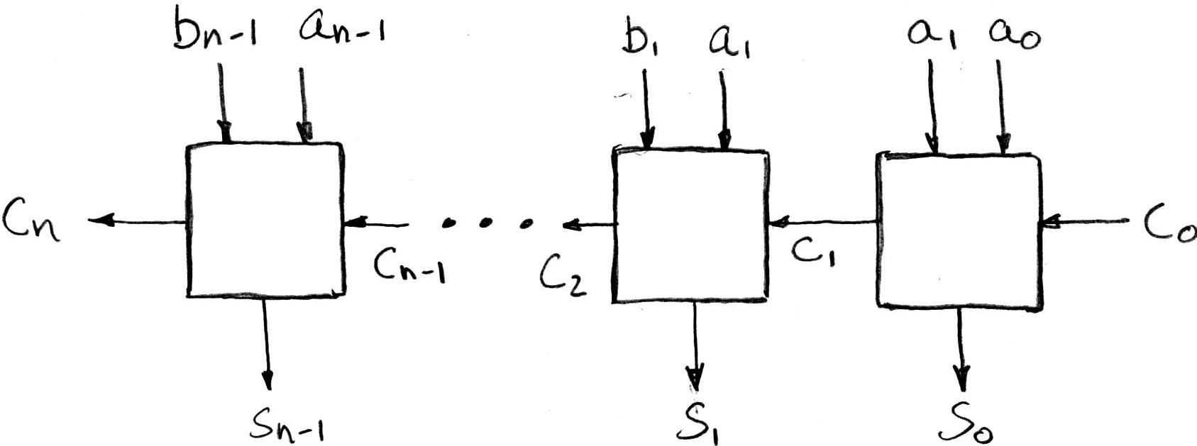
N x 1-bit Adders ⇒ 1 N-bit Adder
Connect Carry Out i-1 to Carry in i:
b₀
+
+
+

Slide 39
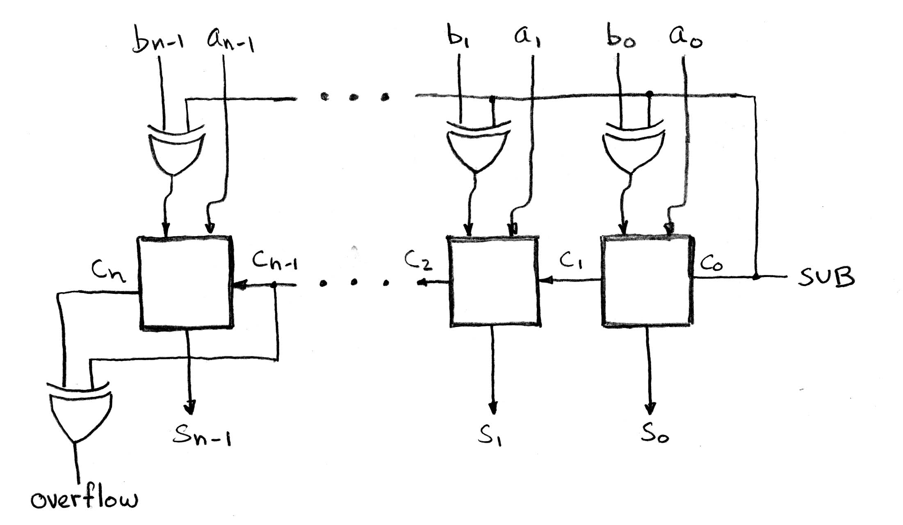
Twos Complement Adder/Subtractor

Slide 40
Critical Path
When setting clock period in synchronous systems, must allow for worst case
Path through combinational logic that is worst case called “critical path”
Can be estimated by number of “gate delays”: Number of gates must go through in worst case
Idea: Doesn’t matter if speedup other paths if don’t improve the critical path
What might critical path of ALU?

Slide 41
Processor Design Process
Five steps to design a processor:
Analyze instruction set → datapath requirements
Select set of datapath components & establish clock methodology
Assemble datapath meeting the requirements
Analyze implementation of each instruction to determine setting of control points that effects the register transfer.
Assemble the control logic
Formulate Logic Equations
Design Circuits
Processor
Input
Control
Memory
Datapath
Output

Slide 42
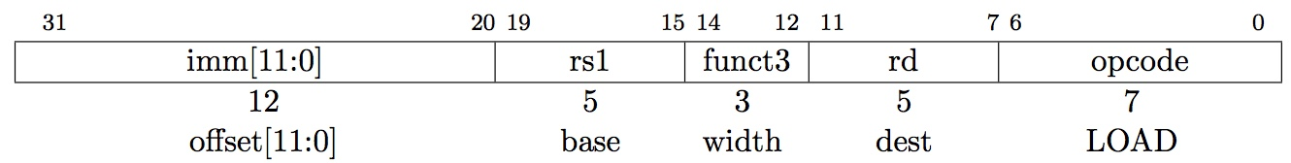
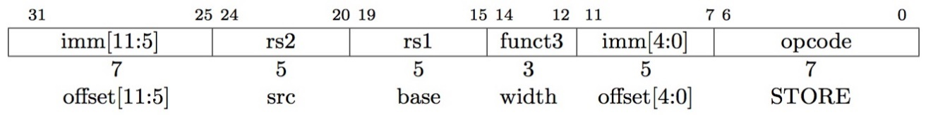
The RISC-V Lite Subset
ADD and SUB
add rd,rs1,rs2
sub rd,rs1,rs2
OR Immediate:
ori rd,rs1,imm12
LOAD and STORE Word
lw rd,rs1,imm12
sw rs2,rs1,imm12
BRANCH:
beq rs1,rs2,imm12

Slide 43
Register Transfer Language (RTL)
RTL gives the meaning of the instructions
{op , rs1 , rs2 , rd , funct3} ← MEM[ PC ]
{op , rs1 , rs2 , Imm12} ← MEM[ PC ]
All start by fetching the instruction
Inst Register Transfers
ADD R[rd] ← R[rs1] + R[rs2]; PC ← PC + 4
SUB R[rd] ← R[rs1] – R[rs2]; PC ← PC + 4
ORI R[rd] ← R[rs1] | sign_ext(Imm12); PC ← PC + 4
LW R[rd] ← MEM[ R[rs1] + sign_ext(Imm12)]; PC ← PC + 4
SW MEM[ R[rs1] + sign_ext(Imm12) ] ← R[rs2]; PC ← PC + 4
BEQ if ( R[rs] == R[rt] ) then PC ← PC + (sign_ext(Imm12) || 0) else PC ← PC + 4

Slide 44
Step 1: Requirements of the Instruction Set
Memory (MEM)
Instructions & data (will use one for each: really caches)
Registers (R: 32 x 32)
Read rs1
Read rs2
Write rd
PC
Sign Extender
Add/Sub/OR unit for operation on register(s) or sign extended immediate
Add 4 (or maybe sign extended immediate) to PC
Compare if registers equal?

Slide 45
Generic Steps of Datapath
rd
PC
instruction
memory
registers
rs1
Data
memory
rs2
ALU
+4
imm
mux
2. Decode/
Register
Read
1. Instruction
Fetch
3. Execute
4. Memory
5. Register
Write

Slide 46
Step 2: Components of the Datapath
Combinational Elements
State Elements + Clocking Methodology
Building Blocks
OP
CarryIn
Select
A
32
A
A
32
32
Zero
Adder
32
Sum
MUX
Y
ALU
Result
32
32
B
32
CarryOut
B
32
B
32
Adder
Multiplexer
ALU

Slide 47
ALU Needs for RISC-V Lite + Rest of RISC-V
Addition, subtraction, logical OR, ==:
ADD R[rd] = R[rs1] + R[rs2]; ...
SUB R[rd] = R[rs1] – R[rs2]; ...
ORI R[rt] = R[rs1] | sign_ext(Imm12)...
BEQ if ( R[rs] == R[rt] )...
Test to see if output == 0 for any ALU operation gives == test. How?
P&H Ch. 4 also adds AND, 64 bit LD/SD instructions
ALU from Appendix A, Section A.5

Slide 48
Storage Element: Idealized Memory
Memory (idealized)
One input bus: Data In
One output bus: Data Out
Memory word is found by:
Address selects the word to put on Data Out
Write Enable = 1: address selects the memory word to be written via the Data In bus
Clock input (CLK)
CLK input is a factor ONLY during write operation
During read operation, behaves as a combinational logic block: Address valid → Data Out valid after “access time”
Write Enable
Address
Data In
DataOut
32
32
Clk

Slide 49
Storage Element: Register (Building Block)
Similar to D Flip Flop except
N-bit input and output
Write Enable input
Write Enable:
Negated (or deasserted) (0): Data Out will not change
Asserted (1): Data Out will become Data In on rising edge of clock
Write Enable
Data In
Data Out
N
N
clk

Slide 50
Storage Element: Register File
Register File consists of 32 registers:
Two 32-bit output busses:
busA and busB
One 32-bit input bus: busW
Register is selected by:
RA (number) selects the register to put on busA (data)
RB (number) selects the register to put on busB (data)
RW (number) selects the register to be written via busW (data) when Write Enable is 1
Clock input (clk)
Clk input is a factor ONLY during write operation
During read operation, behaves as a combinational logic block:
RA or RB valid → busA or busB valid after “access time.”
RW
RA
RB
Write Enable
5
5
5
busA
busW
32 x 32-bit
Registers
32
32
busB
Clk
32

Slide 51
Step 3: Assemble DataPath Meeting Requirements
Register Transfer Requirements → Datapath Assembly
Instruction Fetch
Read Operands and Execute Operation
Common RTL operations
Fetch the Instruction: mem[PC]
Update the program counter:
Sequential Code: PC ← PC + 4
Branch and Jump: PC ← “something else”
clk
PC
Next Address
Logic
Address
Instruction Word
Instruction
Memory
32

Slide 52
Step 3: Add & Subtract
R[rd] = R[rs] op R[rt] (addu rd,rs,rt)
Ra, Rb, and Rw come from instruction’s Rs1, Rs2, and Rd fields
ALUctr and RegWr: control logic after decoding the instruction
… Already defined the register file & ALU
RegWr
rd
rs1
rs2
ALUctr
5
5
5
busA
busW
Rw
Ra
Rb
32
Zero
32 x 32-bit
Registers
ALU
32
busB
32
clk
32
Result

Slide 53
And in Conclusion, …
State Machines
Finite State Machines: made from Stateless combinational logic and Stateful “Memory” Logic (aka Registers)
Clocks synchronize D-FF change (Setup and Hold times important!)
Pipeline long-delay CL for faster clock cycle - Split the critical path
Use muxes to select among inputs
S input bits selects 2S inputs
Each input can be n-bits wide, independent of S
Can implement muxes hierarchically
Arithmetic circuits are a kind of combinational logic
Processor
Input
Control
Memory
Datapath
Output
Five steps to processor design:
Analyze instruction set → datapath requirements
Select set of datapath components & establish clock methodology
Assemble datapath meeting the requirements
Analyze implementation of each instruction to determine setting of control points that effects the register transfer.
Assemble the control logic
Formulate Logic Equations
Design Circuits

